Slide 1
Introduction to DaLI: A Data Lifecycle Instrument for Management and Sharing of Data from Instruments and Observations
Nov 14th 2019
Kazutaka Takahashi
kazutaka@uchicago.edu
rcc.uchicago.edu

Slide 2
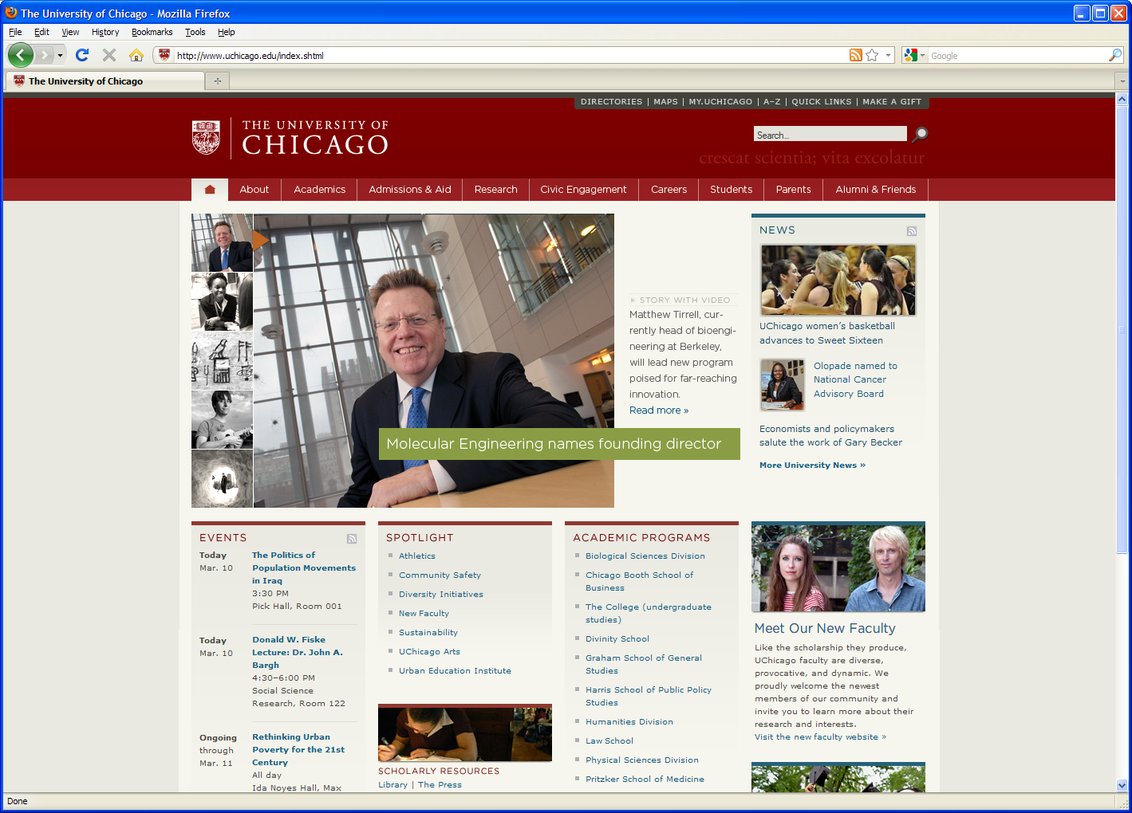

Outline
Introduction and Motivation
Data Management
The DaLI platform
DaLI compute nodes and Data mover
DaLI storage
Software on DaLI
Getting started with using DaLI
Examples of supported projects on DaLI

Slide 3
Researchers today are generating volume of data from instruments and observations at accelerating rates, resulting in extreme challenges in data management and computation.
Notes:
Approaches/Solutions
Material model:
Perform experiments on human tissues to extract material properties
Space aspects:
Hybrid approach: Develop Beam-Model in conjunction with mass-spring model, FEM model, Meshfree model if necessary, Large deformation and nonlinear aspects
Reduced order models which retain the rich physics
Time aspects
Efficient Forward displacement time integration methods for computational efficient and suitable for accurate modeling of dynamic interactions
Collision detection and collision response
Spatial tessellation based method as fast and robust collision detection to handle complicated VR scenarios
non rigid deformation
use FEM for non rigid registration :
piece wise polynomial approximation
crude approximation: linear element mode

Slide 4
90% of the world’s data was created in the last two years
Katharine Frase SC16

Slide 5
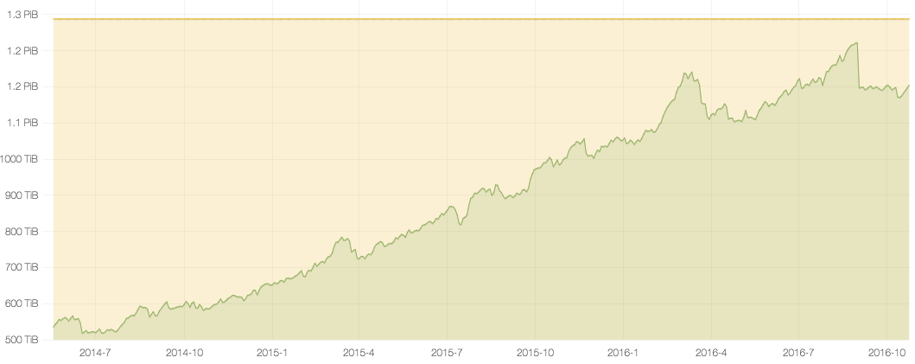
Users add an average of 1.5TB of data per day to the UChicago RCC Storage
The deluge of data is real …
Midway1 Storage usage over time
As
23
Notes:
Yellow Line represents the Maximum Capacity of MIdway1 project space
Through the end of FY16 PI’s have purchased over 1.2PB of high capacity storage on Midway.
The Strategic Plan will need to consider:
How to meet the growing need for Data Storage
Where to store this ever increasing quantity of data

Slide 6
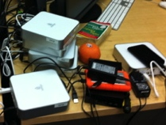
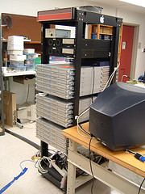
What we are seeing today in many labs … ..
Poor data management
Inadequate software, ad hoc solutions
Lack of skills
Poor performance, excessive costs
Images courtesy of I. Foster

Slide 7
Motivation
Instruments are generating terabytes of data per day
Researchers are currently storing their data on inadequate media with no consistent back up mechanism.
Data storage and compute resources are highly distributed
Data must be transferred from remote locations, field stations or core facilities to the user’s home system
Fragmented data landscape with data often spread across many local and national facilities
Need to leverage local and national infrastructure
Need for sharing data – DMP requirements
Need for real time steering of experiments
Etc.

Slide 8
The Data Lifecycle
Acquire
Store
Process
Share
transfer

Slide 9
What is DaLI?
The Data Lifecycle Instrument (DaLI), enables management and sharing of data from instruments and observations, allowing researchers to:
acquire, transfer, process, and store data from experiments and observations in a unified workflow.
manage data collections over their entire lifecycle.
share and publish data.
enhance outreach and education opportunities
DaLI is an NSF funded project

Slide 10
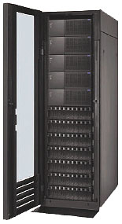
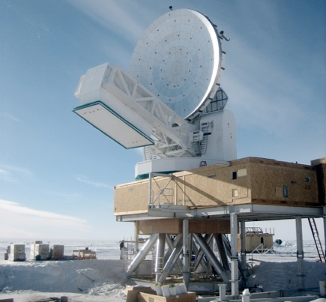
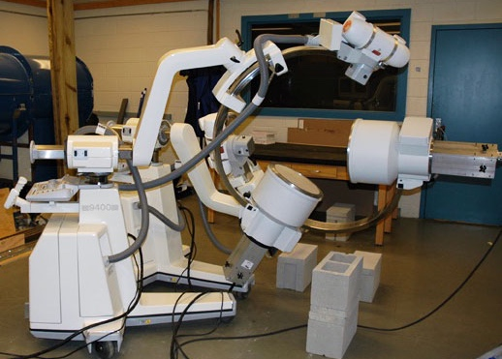
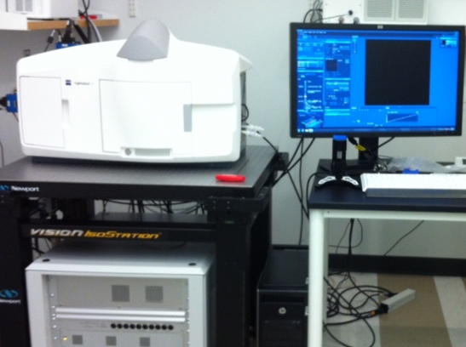
DaLI From collecting data on an instrument to analyzing data on a HPC cluster
Field Stations,
Research Labs
Data
Acquisition
Instrument
Data
Sharing
XDM
Globus
MyTardis
Etc.
Broader
Community
Data Pre- & Post-
Processing
Data
transport / storage
XSEDE
CERN,
ANL
etc.
South Pole
Telescope
X Ray Reconstruction of Moving Morphology Instrument
Lightsheet
Microscope
XENON1T
Dark Matter
Detector

Slide 11
DaLI Platform
Four pools of resources:
A high-performance compute resource for pre- and post-processing of data,
a high performance storage pool,
a low cost storage pool, and
a tape backup pool
DaLI is designed to have software tools such as Globus, MyTARDIS, RCC XDM or any other for data lifecycle management and integration with the campus and national cyberinfrastructures.

Slide 12
DaLI Website
Recently updated
https://dali.rcc.uchicago.edu

Slide 13
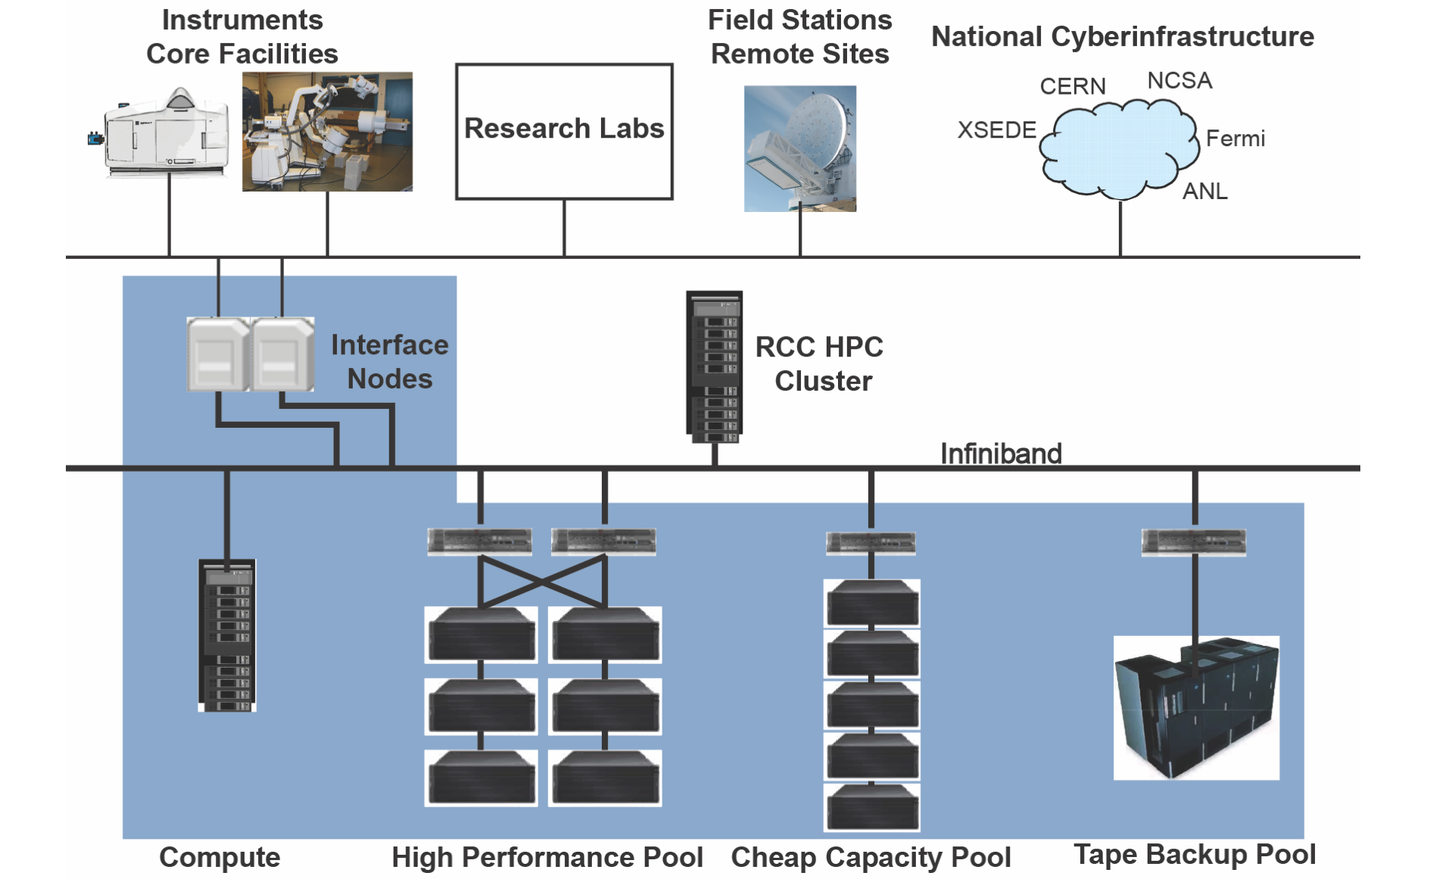
f

Slide 14
DaLI Compute nodes
Compute nodes: 30 nodes – 1,200 cores
2x Intel Xeon Gold 6148 (20 core 2.4GHz),
96GB DDR4 2666MHz DIMM
100Gb/s EDR (InfiniBand)
Data Mover node:
2x Intel Xeon Gold 6148 (20 core 2.4GHz)
192GB DDR4 2666MHz DIMM
100Gb/s EDR
40Gb Ethernet
2x 480GB SSD

Slide 15
DaLI Storage
Capacity Storage: ~ 2 PB storage usable
DDN GridScaler 14,000Xe
420x 10TB Near-line 7.2K SAS HDD
12x 1.92TB SAS SSD metadata
Usable capacity: 2PB
GPFS file system
Cost effective storage
Tape backup

Slide 16
Software available on DaLI
All the modules that are available on Midway2 are loadable using module command

Slide 17
Transfer your data
Globus lets you efficiently, securely, and reliably transfer
data directly between systems

Slide 18
Data Transport : Globus
high-performance data transfers between systems

Slide 19
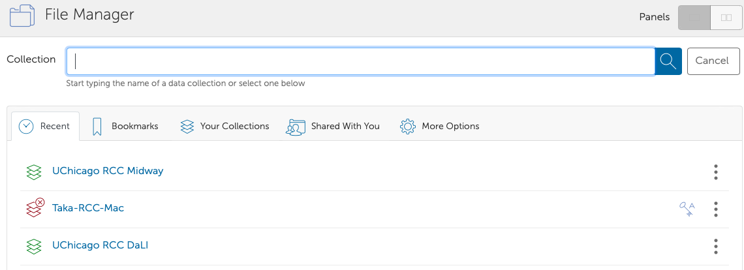
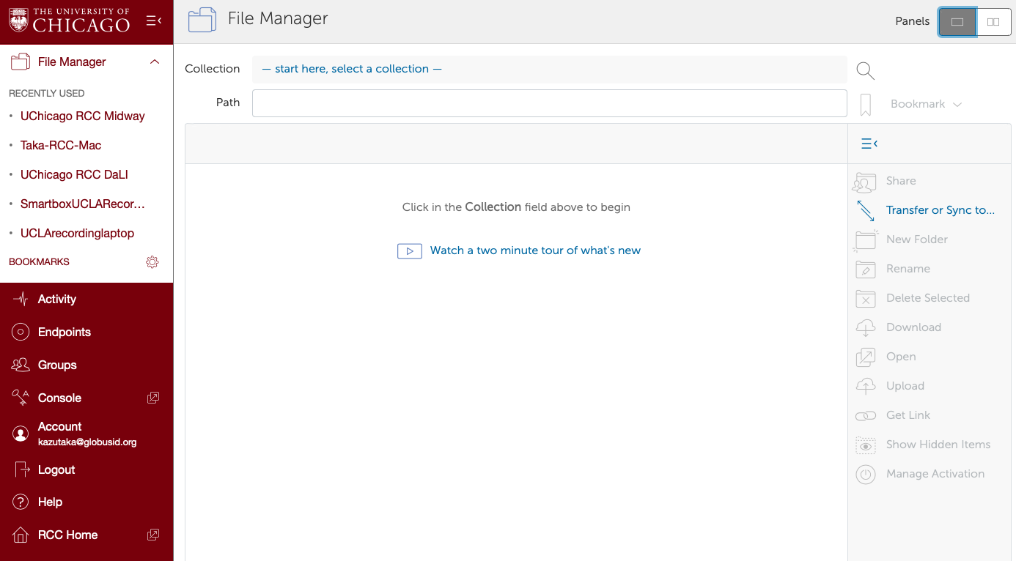
How to use Globus?
https://globus.rcc.uchicago.edu/

Slide 20
MyTardis: A data management system
Capture data at its source: ensures the data is Findable and Accessible
Add value to instrument. Extensible data processing architecture. Partner with users to develop unique views and filtering of data
Distribute data without a fuss: Securely and automatically shifting data from instrument to repository, accessible by the right users or user groups.
Data publications: Facilities can open selected data to the world, adding key information relating to research publications, derivative data and downstream analysis.
Push data to Compute: ‘Push To’ feature allows users to seamlessly transfer data directly from MyTardis to HPC
Facility View: provides facility staff with a total view of data generation from all instruments. Filter by user, instrument or browse the summary page for the ultimate view of data activity within the facility. It enables facility staff to fix ownership issues for unowned data, and share data with external researchers.

Slide 21
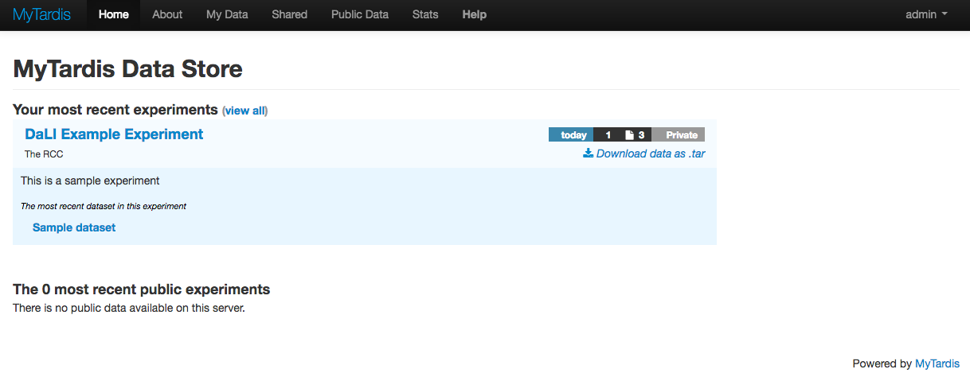
MyTardis: DaLI installation

Slide 22
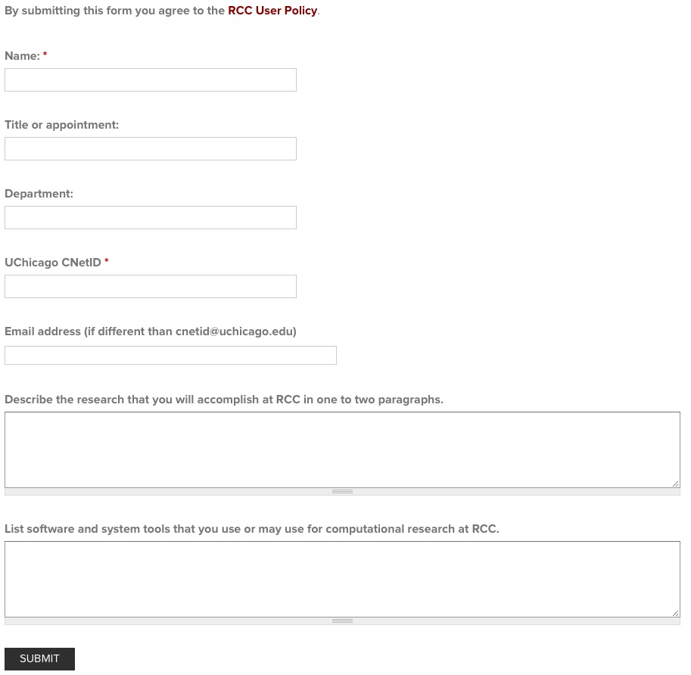
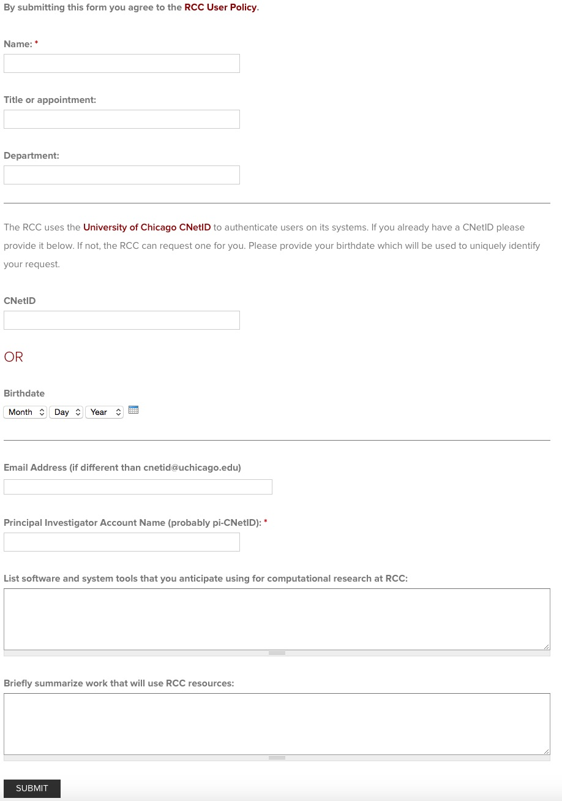
How to get an account on DaLI
Supported projects and approved projects
PI Account Request
General User Account Request
Complete a form at rcc.uchicago.edu - General User Account requires a PI account

Slide 23
Login procedure
DaLI account credentials are your UChicago Cnet ID and password
To login from a terminal
Example: ssh kazutaka@dali-login.rcc.uchicago.edu
Username: your CNetID
Password: your CNetID password
Hostname: dali-login.rcc.uchicago.edu
ssh –Y {CNETID}@dali-login.rcc.uchicago.edu
Notes:
Increase resolution of images

Slide 24
Accessing DaLI
Window users: use either
Mobaxterm: Comes bundled with X Server so it is X11 forwarding capable. Also has an sftp tab built in to the client
cygwinX
Windows10 users can use the Windows subsystem for Linux

Slide 25

Accessing via GUI
We use the Thinlinc Client.
You can either access the web version of Thinlinc or download the client
Access from browser the following:
https://midway2.rcc.uchicago.edu/main/
This is the best tool for displaying applications that require X-forwarding if you are having trouble working with your ssh X11 forwarding enabled session.
From terminal X forwarding can be achieved with –X or –Y For example:
For Linux distributions X Server is typically installed by default.
For Windows users using MobaXterm, the default ssh connection is with X11 forwarding enabled.
ssh –Y {CNETID}@dali-login.rcc.uchicago.edu

Slide 26
Transferring Files
Secure copy protocol: scp on Linux and OSX and WinSCP on Windows
SFTP
rsynch
Globus Online
use endpoint: ucrcc#dali
Notes:
increased resolution of text image.
SAMBA is available on Windows, Mac and Linux
Removed HTTP protocol for file transfer

Slide 27
Job submissions
Job submissions to DaLI and Midway2 are managed by Slurm, but they are physically different clusters.
Thus, you should use a right pair:
If you are running jobs off of files on DaLI, you should login to DaLI and submit jobs with partition being specified with DaLI:
--partition=dali
to use DaLI compute nodes
Notes:
increased resolution of text image.
SAMBA is available on Windows, Mac and Linux
Removed HTTP protocol for file transfer

Slide 28
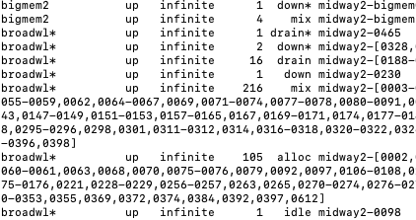
Job submissions
Usually compute nodes on DaLI are not well utilized, compared to broadwl nodes for the entire campus
Notes:
increased resolution of text image.
SAMBA is available on Windows, Mac and Linux
Removed HTTP protocol for file transfer

Slide 29
Example of supported projects on DaLI

Slide 30
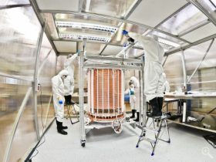
Telescopes and Arrays-Astronomy and Astrophysics (3.9 PB)
A new, 3.3 ton Xenon detector (XENON1T) : up to 30TB of raw data per day.
South Pole Telescope (SPT). The SPT-3G installed in 2016 and will be 20 times more sensitive than the previous detector. To generate over 600TB of data per year.
The Cherenkov Telescope Array (CTA). 200TB of data per year
Figure : Xenon1T dark matter detector in the Gran Sasso Underground Laboratory in Italy. Data is analyzed at the RCC
Notes:
Xenon: research focuses on searching for dark matter by looking at rare interactions in specialized low-background detectors.
SPT: the SPT collaboration provided insights into the structure of galaxies and expanded the understanding of physics immediately following the Big Bang

Slide 31
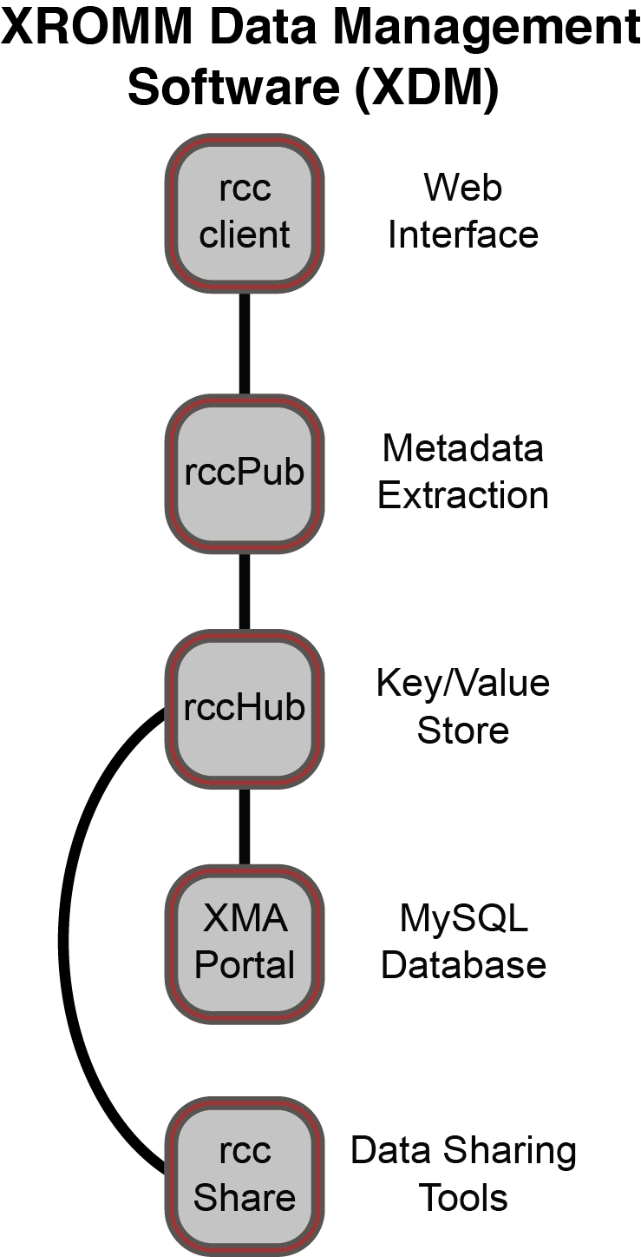
Multidisciplinary Neuroscience (230 TB)
Biplanar Digital Videofluoroscopy Instrument for X-ray Reconstruction of Moving Morphology (XROMM)
Center for Cognitive and Social Neuroscience: up to 1 TB of data per study

Slide 32
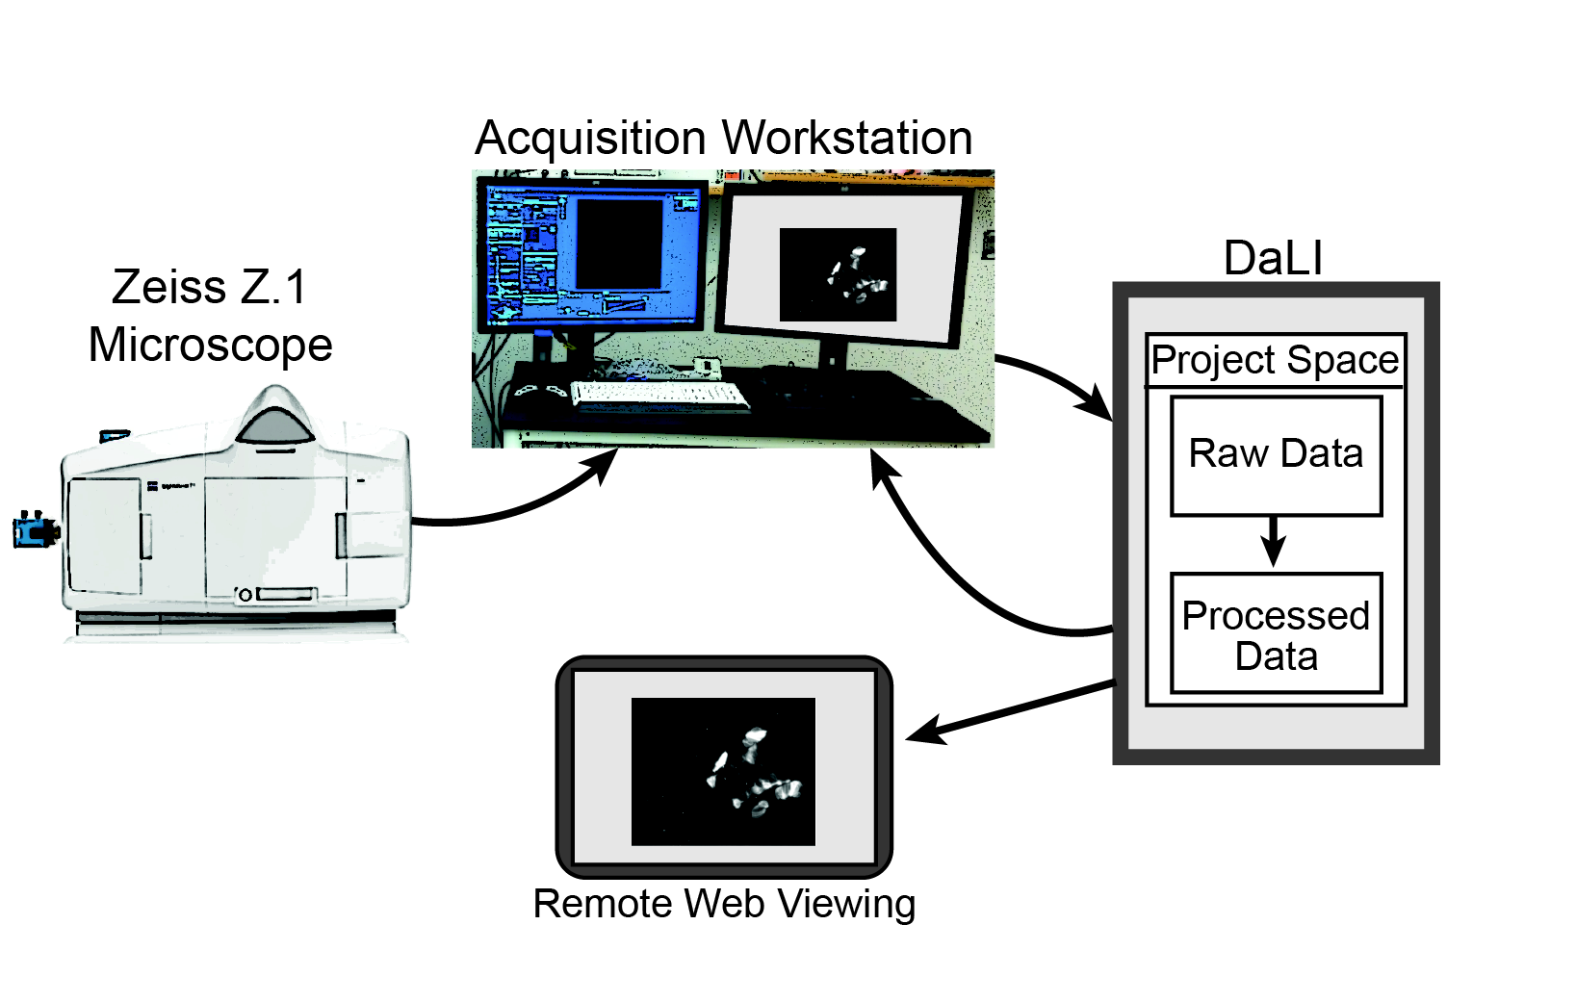
Microscopes (75 TB)
Confocal microscopy
light sheet microscopy
LC-PolScope
CryoEM
Figure . Workflow of Light Sheet microscopy tools for image acquisition This software leverages HPC resources to process the acquired data acquired and make those images available on the acquisition computer or remotely for monitoring
Field Stations and Sensors- Ecology and Ecosystems (262 TB)
Massively Parallel Sequencing- Microbial Ecology and Biology (4.1 PB)
High Speed/High Definition Video Camera (381 TB)

Slide 33
Project example: XDM
XDM: XROMM Data Management Portal

Slide 34
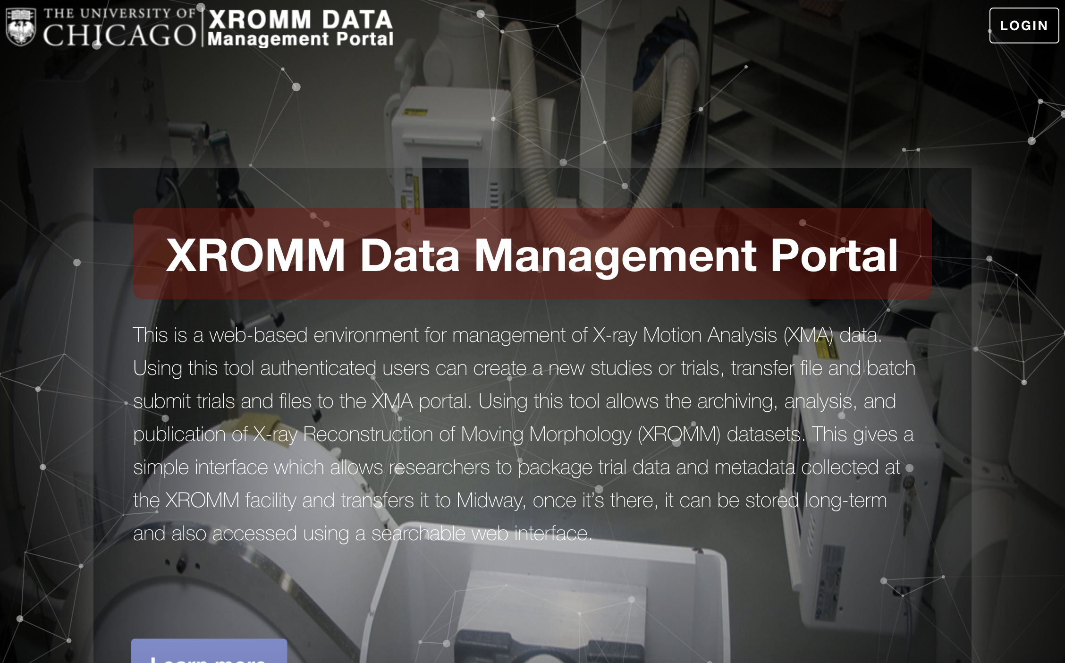

Slide 35
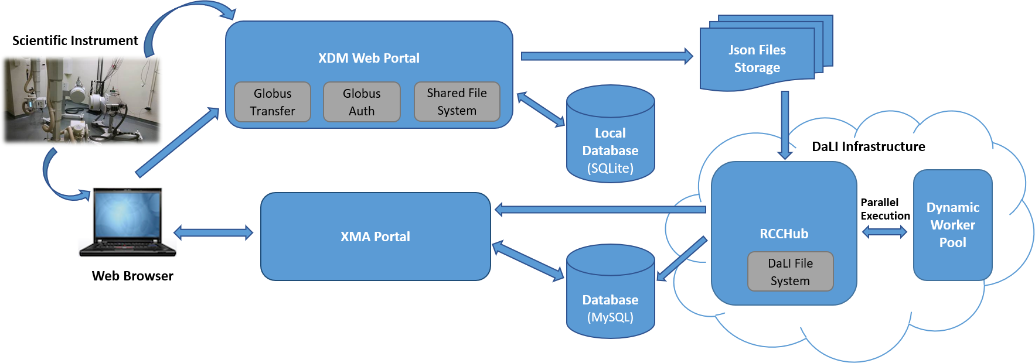
XDM system architecture
Overall architecture - The XDM system is comprised of 4 core components:
XDM Web Portal
DaLI Infrastructure
RCCHub
UChicago XMA Portal

Slide 36
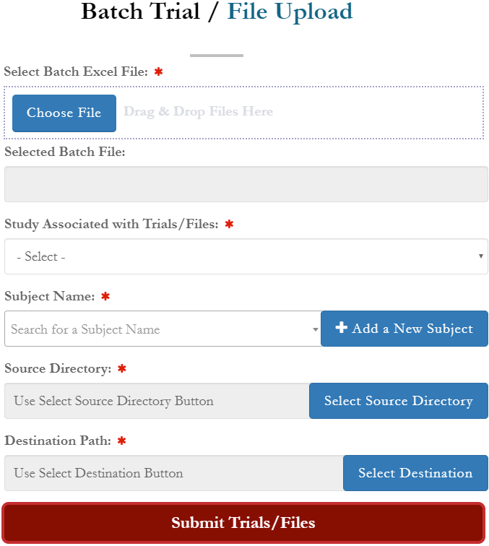
After hardware enhancement
We can obtain a few hundreds of “trials” per experiment per day
Needed to develop batch loading functionality and metadata set

Slide 37
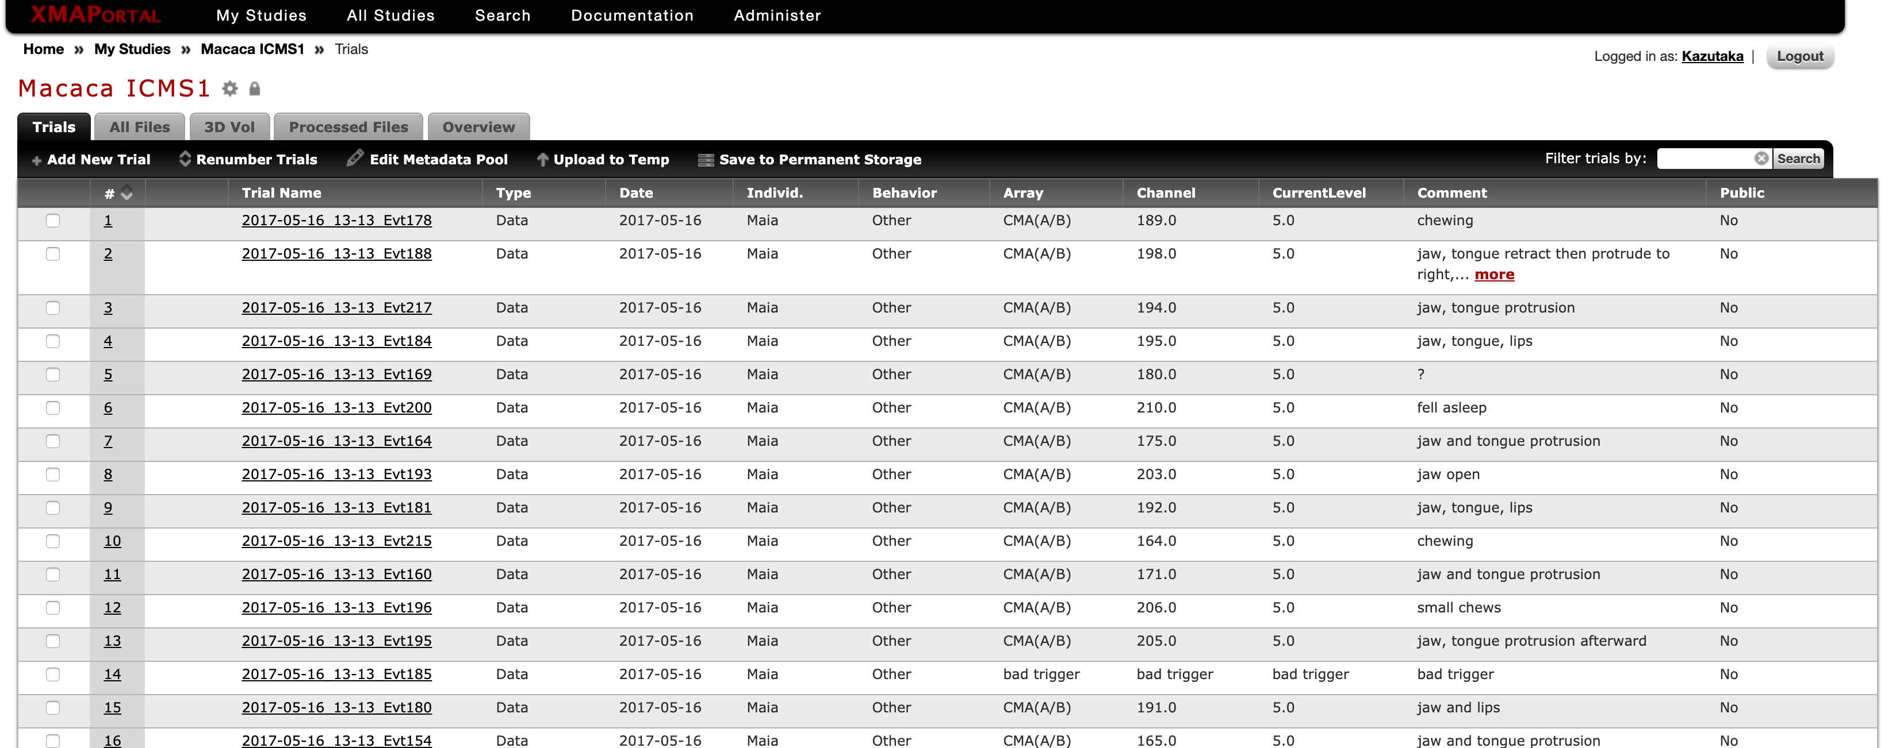
Organizations on Studies and Trials

Slide 38
Any specific workflow for your group?

Slide 39
RCC Help
Email: help@rcc.uchicago.edu
Phone: 773-795-2667
Web: rcc.uchicago.edu
In person: Regenstein room 216 or 5607 S Drexel Ave

Slide 40
Thank you
kazutaka@uchicago.edu
Help? Questions? help@rcc.uchicago.edu
Notes:
William Rando , Director Chicago Center for Teaching.

